Slide 1
Dinner In The Sky
CS – 1201L
Introduction to Information and Communication Technology Lab
Group Leader: Muhammad Abubaker Gohar (cs201076)
Group member: Lokesh Kumar Shamwani (cs201052)
Group member: Muhammad Kownain Qadir (cs201074)
Group member: Mohammad Saad Sheikh (cs201061)

Slide 2
Introduction:
Dinner in the sky works on the refined structure of a flying table, it stands high in the sky with the most beautiful view all around. The functions performed by dinner in the sky are the depiction of all sort of happy hours of the human life. It can either be a celebration of any sports, brand showcase, wedding event.
Most importantly being a unique dine-in internationally now introducing in Karachi, Pakistan. Being 200 feet above the ground with maximum 40 seats table, with a beautiful view of whole town from the sky and worth watching beautiful sunset.

Slide 3
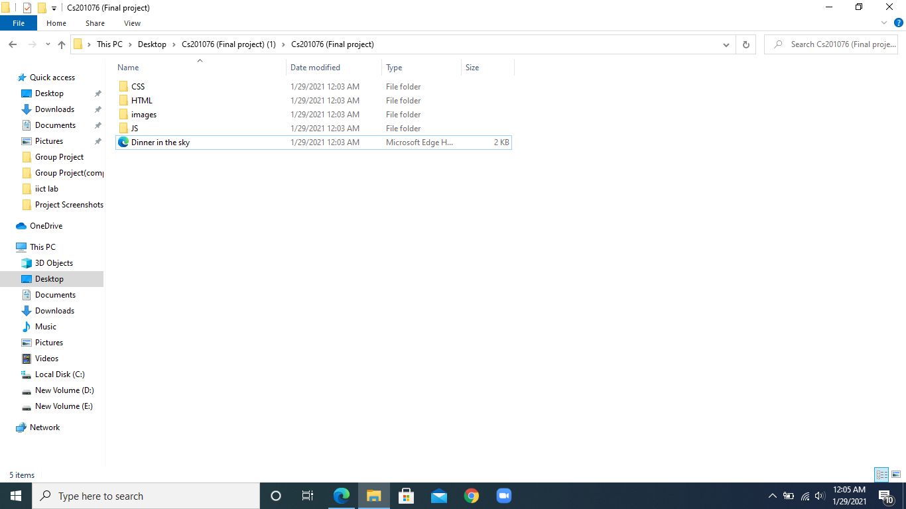
Project Main Folder:

Slide 4
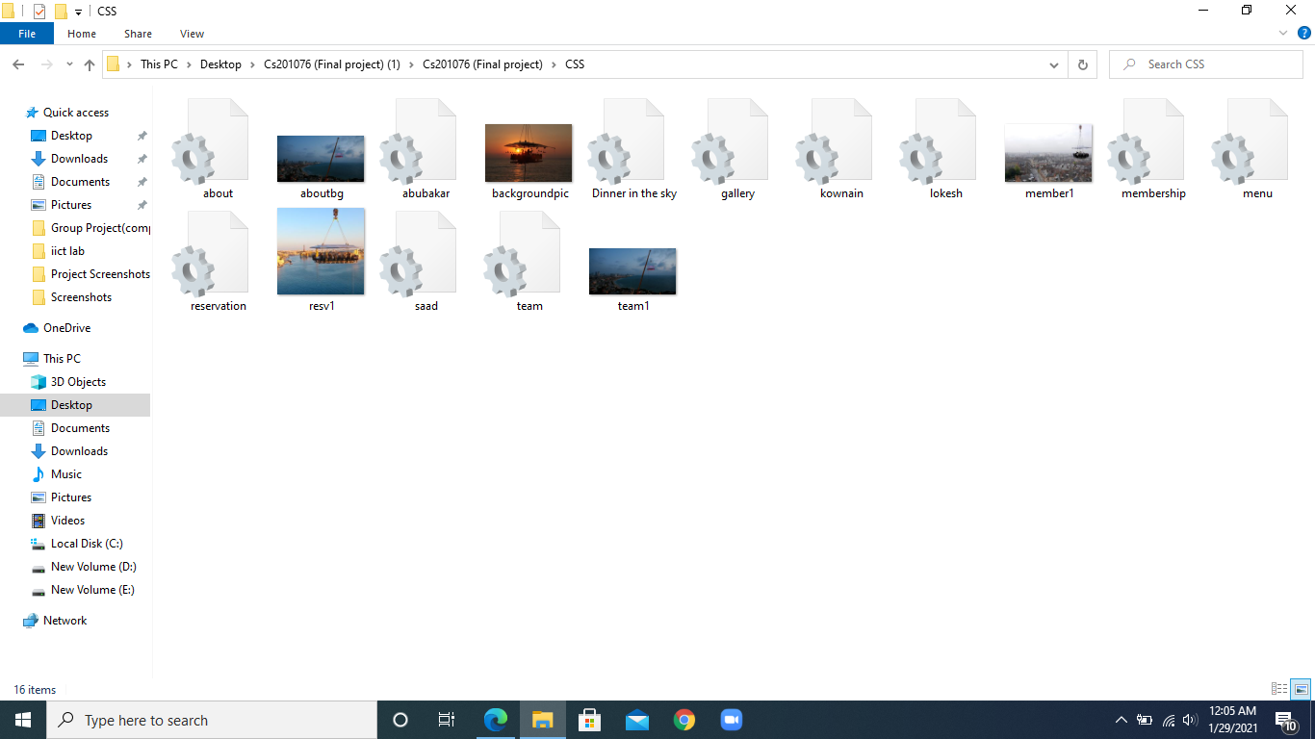
CSS Folder:

Slide 5
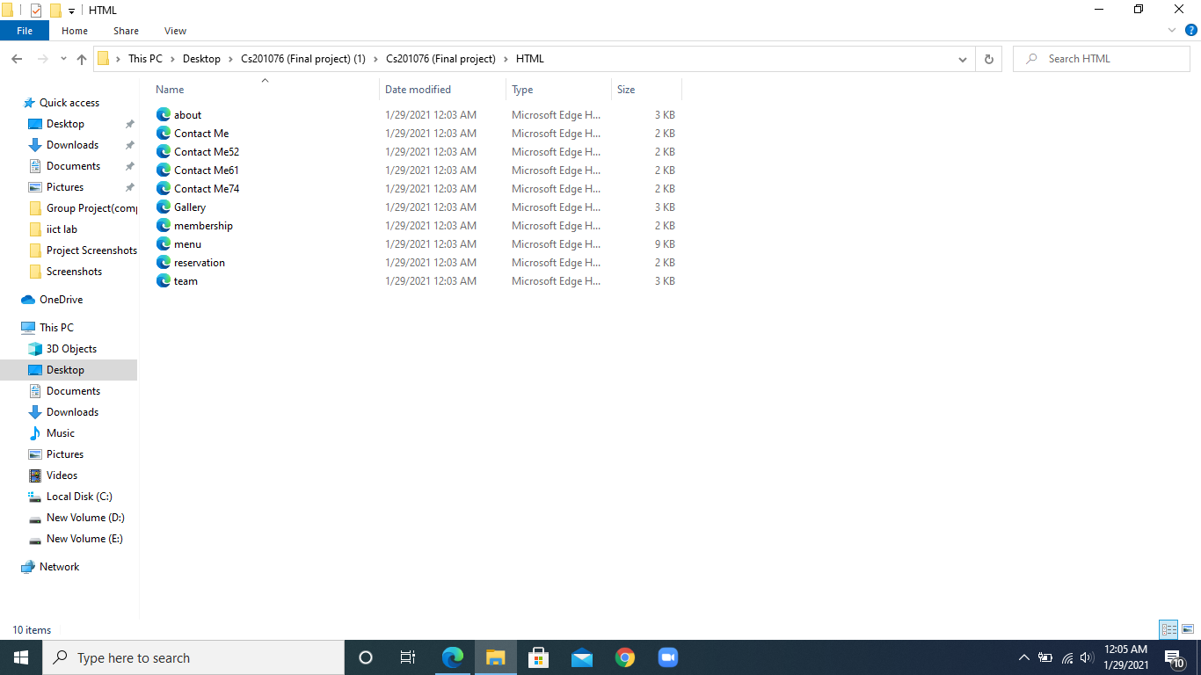
Html Folder:

Slide 6
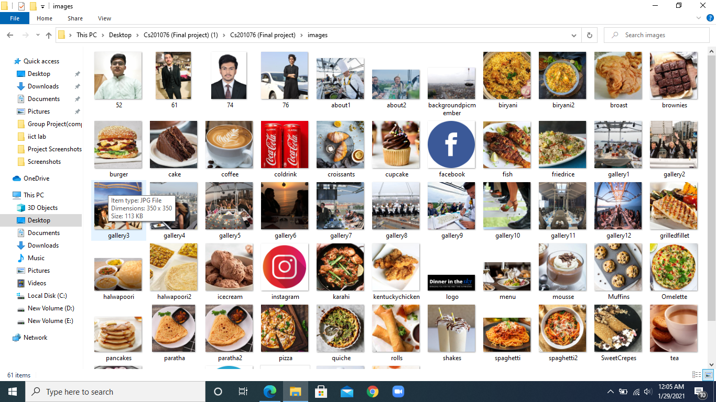
Images Folder:

Slide 7
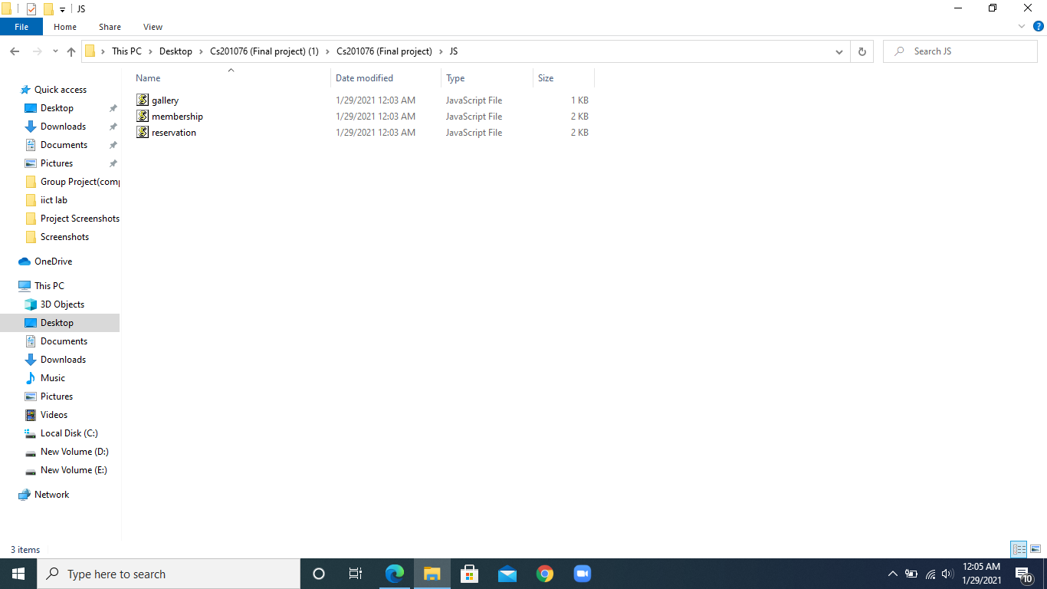
Java Script folder:

Slide 8
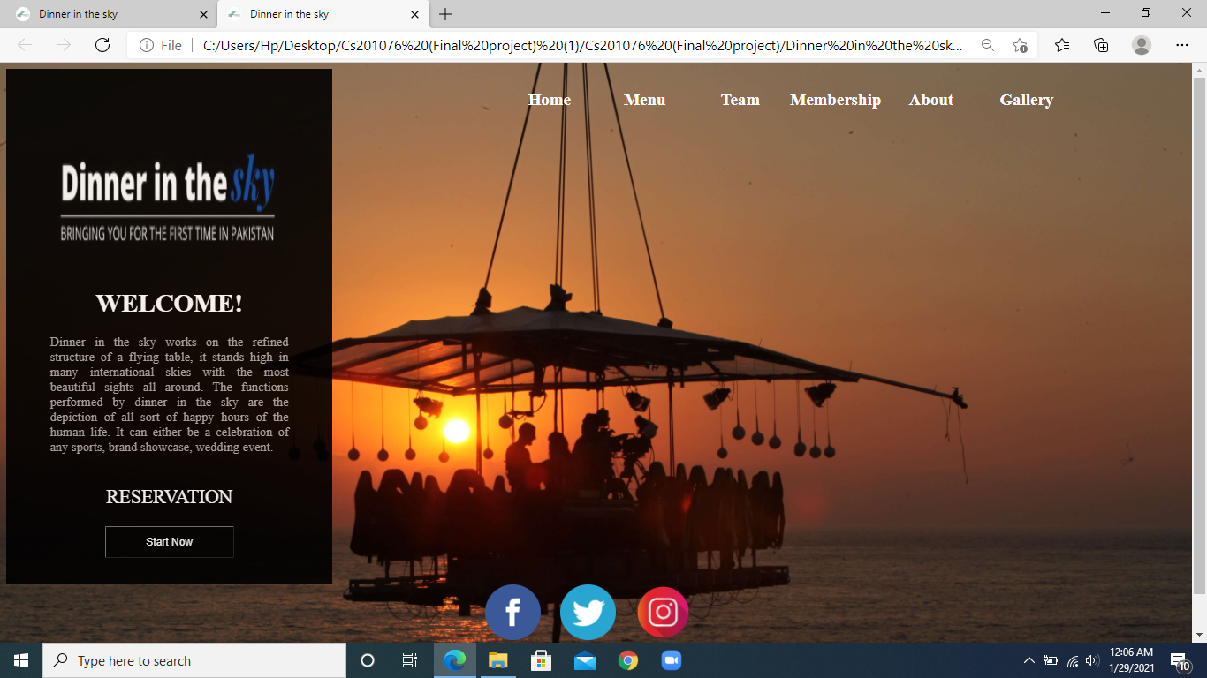
Home Web Page:

Slide 9
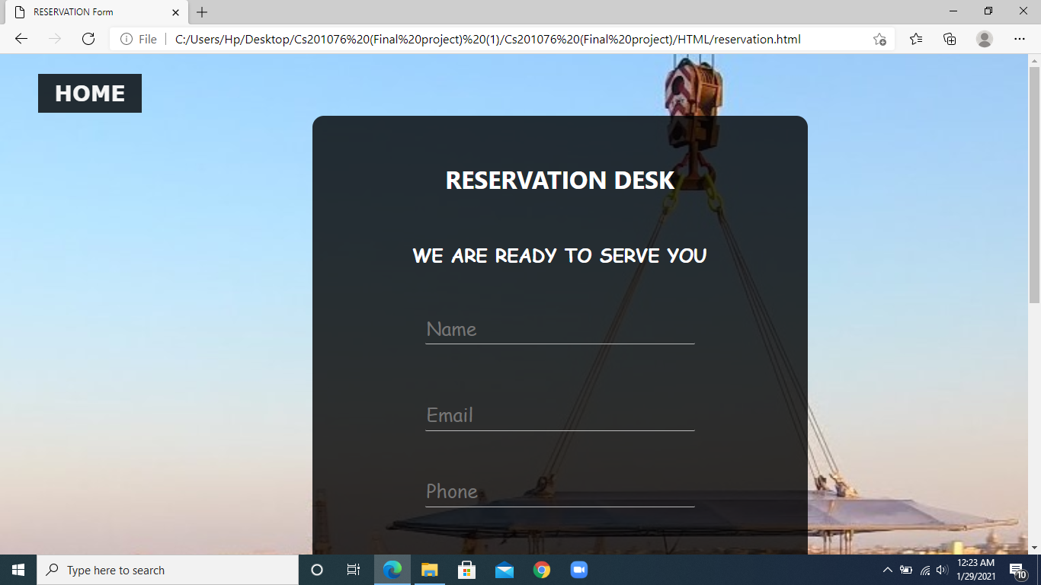
Reservation Form Page:

Slide 10
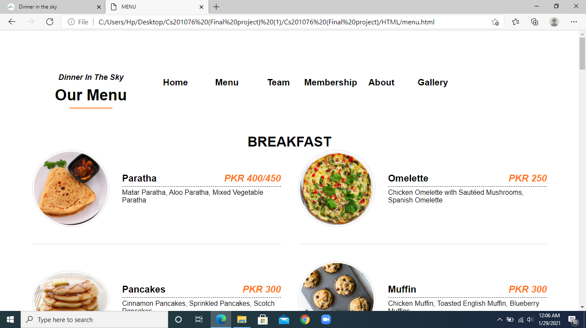
Menu Page:

Slide 11
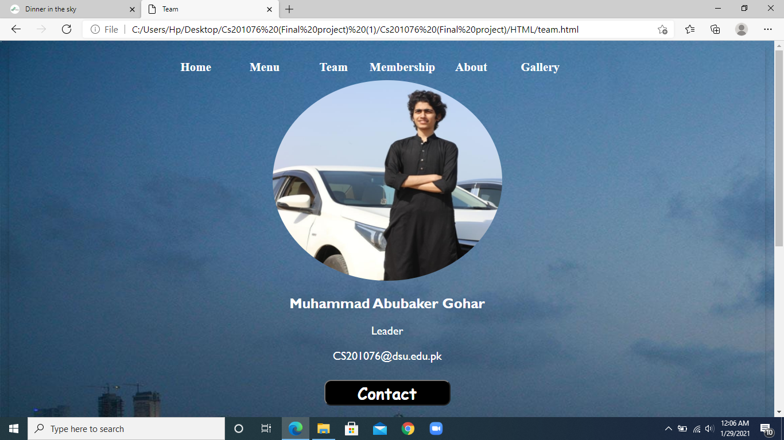
Team Page:

Slide 12
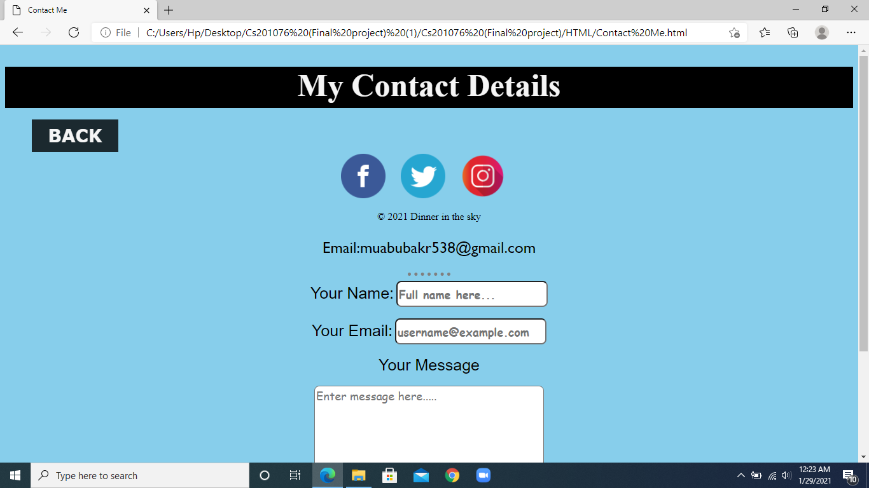
Contact Page:

Slide 13
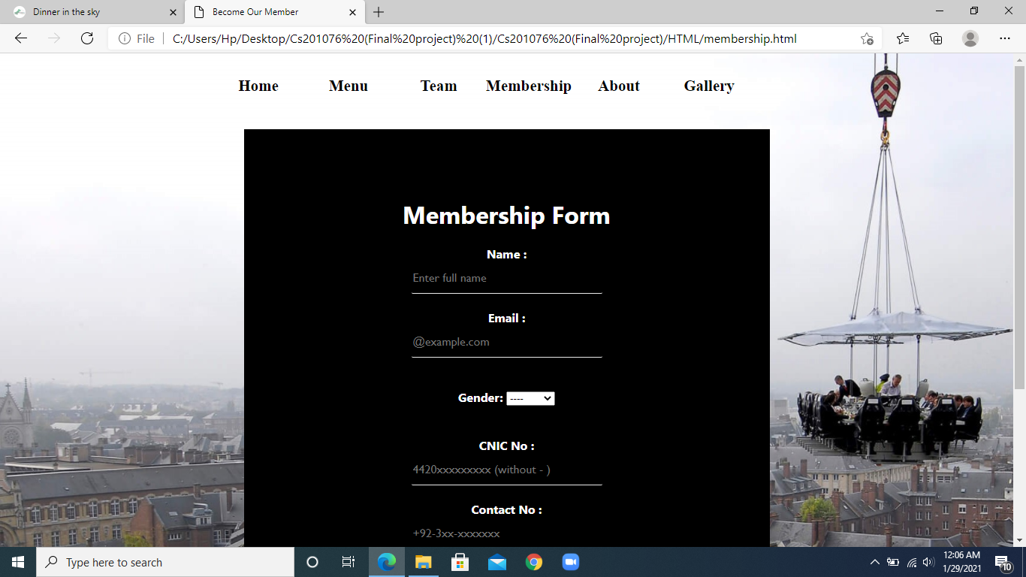
Membership Page:

Slide 14
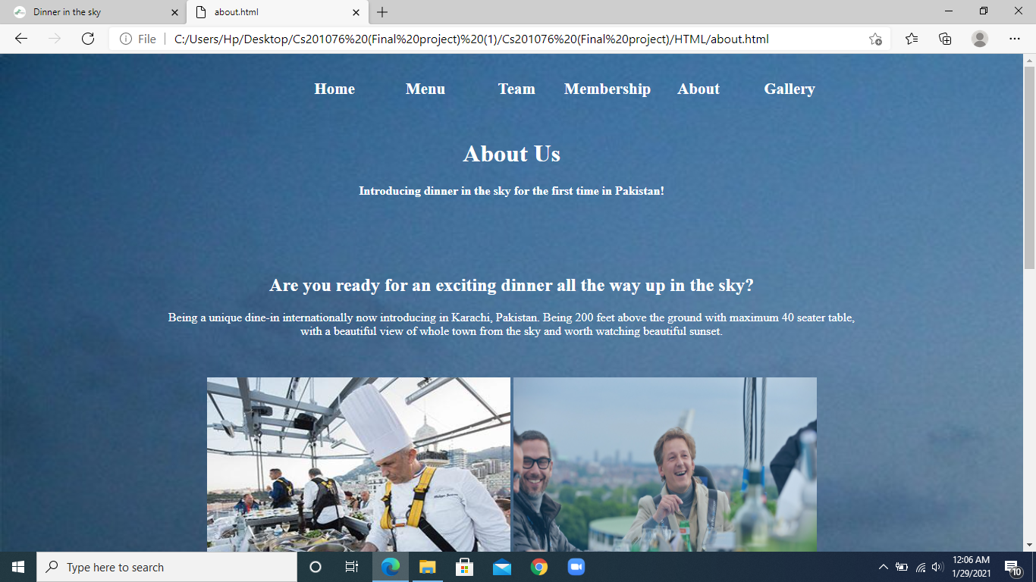
About Page:

Slide 15
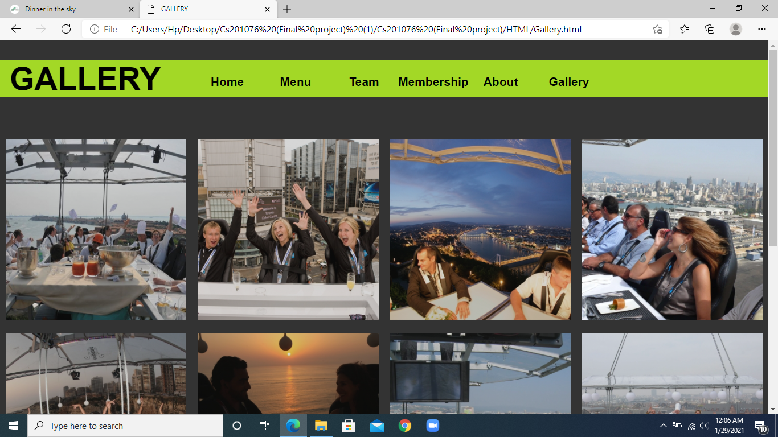
Gallery:

Slide 16
Division of Work
We divided Our Pages In Following manner:
Abubaker = Home, Gallery, Menu
Kownain = About , Contact
Lokesh = Reservation, Membership
Saad Shekih = pathing , Team

Slide 17
Purpose Of This Topic In Project:
As per the fact of having a most common idea of project which is making a website on restaurant, we decided to approach with a unique way of introducing Dinner In The Sky for the first time in Karachi, Pakistan.
Every member including the group leader worked really hard and co-operated with other while making of this project. We cleared our group member’s problems in a zoom meeting call when needed. This project is a pure example of our co-ordination.

